Slide 1
Assembler

Slide 2
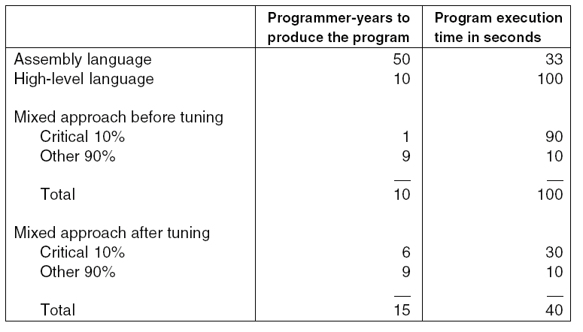
Why Use Assembly Language?
Comparison of assembly language and high-level language
programming, with and without tuning.

Slide 3
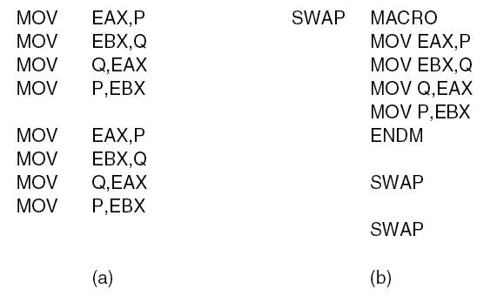
Macro Definition, Call, Expansion (1)
Assembly language code for interchanging P and Q twice.
(a) Without a macro. (b) With a macro.

Slide 4
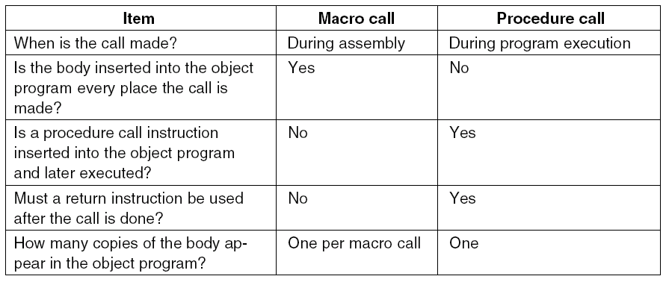
Macro Definition, Call, Expansion (2)
Comparison of macro calls with procedure calls.

Slide 5
Branch Loop
-
-
-
-
Loop Add R1 R2
Known As forward reference problem

Slide 6
Solution is a two pass Assembler:
On pass one: Reading the assembly program once, converting it to an intermediate form, and storing this intermediate form in a table in memory.
Second pass: is made over the table instead of over the source program.

Slide 7
Pass one
The principal function of pass one is to build up a table called the symbol table, containing the values of all symbols.
A symbol is either a label or a value that is assigned a symbolic name by means of a pseudoinstruction such as
BUFSIZE EQU 8192
In assigning a value to a symbol in the label field of an instruction, the assembler must know what address that instruction will have during execution of the program.

Slide 8
To keep track of the execution-time address of the instruction being assembled, the assembler maintains a variable during assembly, known as the ILC (Instruction Location Counter).
This variable is set to 0 at the beginning of pass one and incremented by the instruction length for each instruction processed.
Pass one of most assemblers uses at least three internal tables:
the symbol table,
the pseudoinstruction table, and
the opcode table.

Slide 9
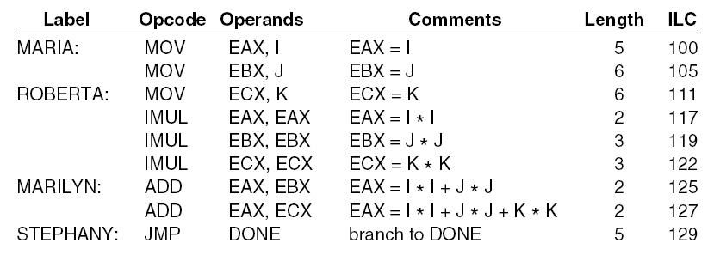
Two Pass Assemblers (1)
The instruction location counter (ILC) keeps track of the address
where the instructions will be loaded in memory. In this example, the statements prior to MARIA occupy 100 bytes.

Slide 10
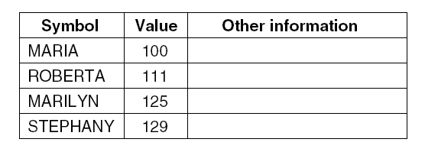
Two Pass Assemblers (2)
Other information may include
The length of data field associated with symbol.
2. The relocation bits. (Does the symbol change value if the program is loaded at a different address than the assembler assumed?)
3. Whether or not the symbol is to be accessible outside the procedure.

Slide 11
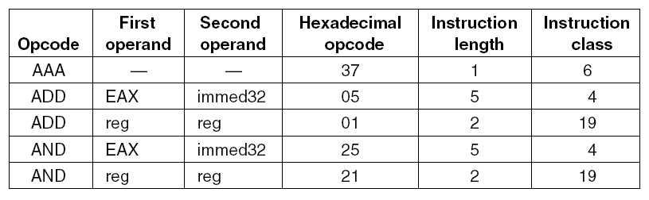
Two Pass Assemblers (3)
A few excerpts from the opcode table for a Pentium 4 assembler.

Slide 12
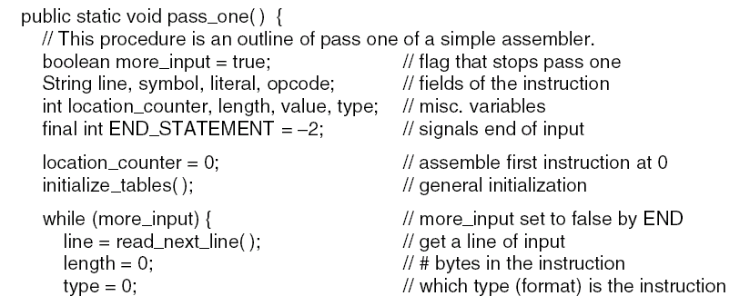
Pass One (1)
Pass one of a simple assembler.
. . .

Slide 13
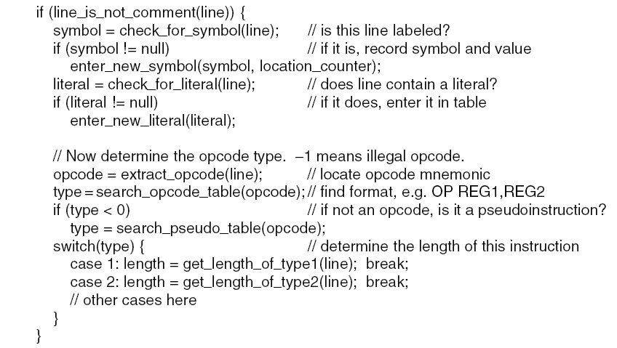
Pass One (2)
. . .
Pass one of a simple assembler.
. . .

Slide 14
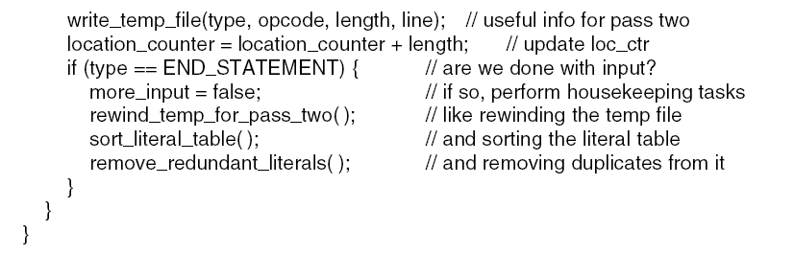
Pass One (3)
. . .
Pass one of a simple assembler.

Slide 15
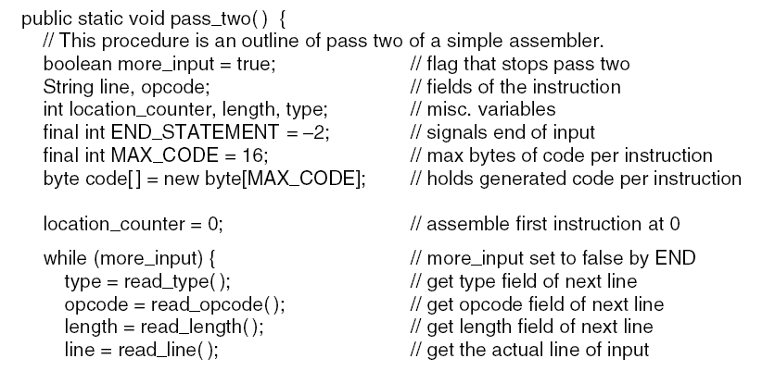
Pass Two (1)
Pass two of a simple assembler.
. . .

Slide 16
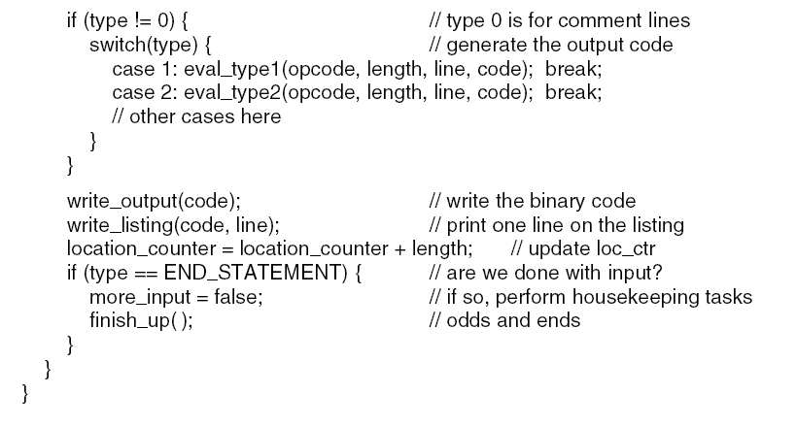
Pass Two (2)
. . .
Pass two of a simple assembler.

Slide 17
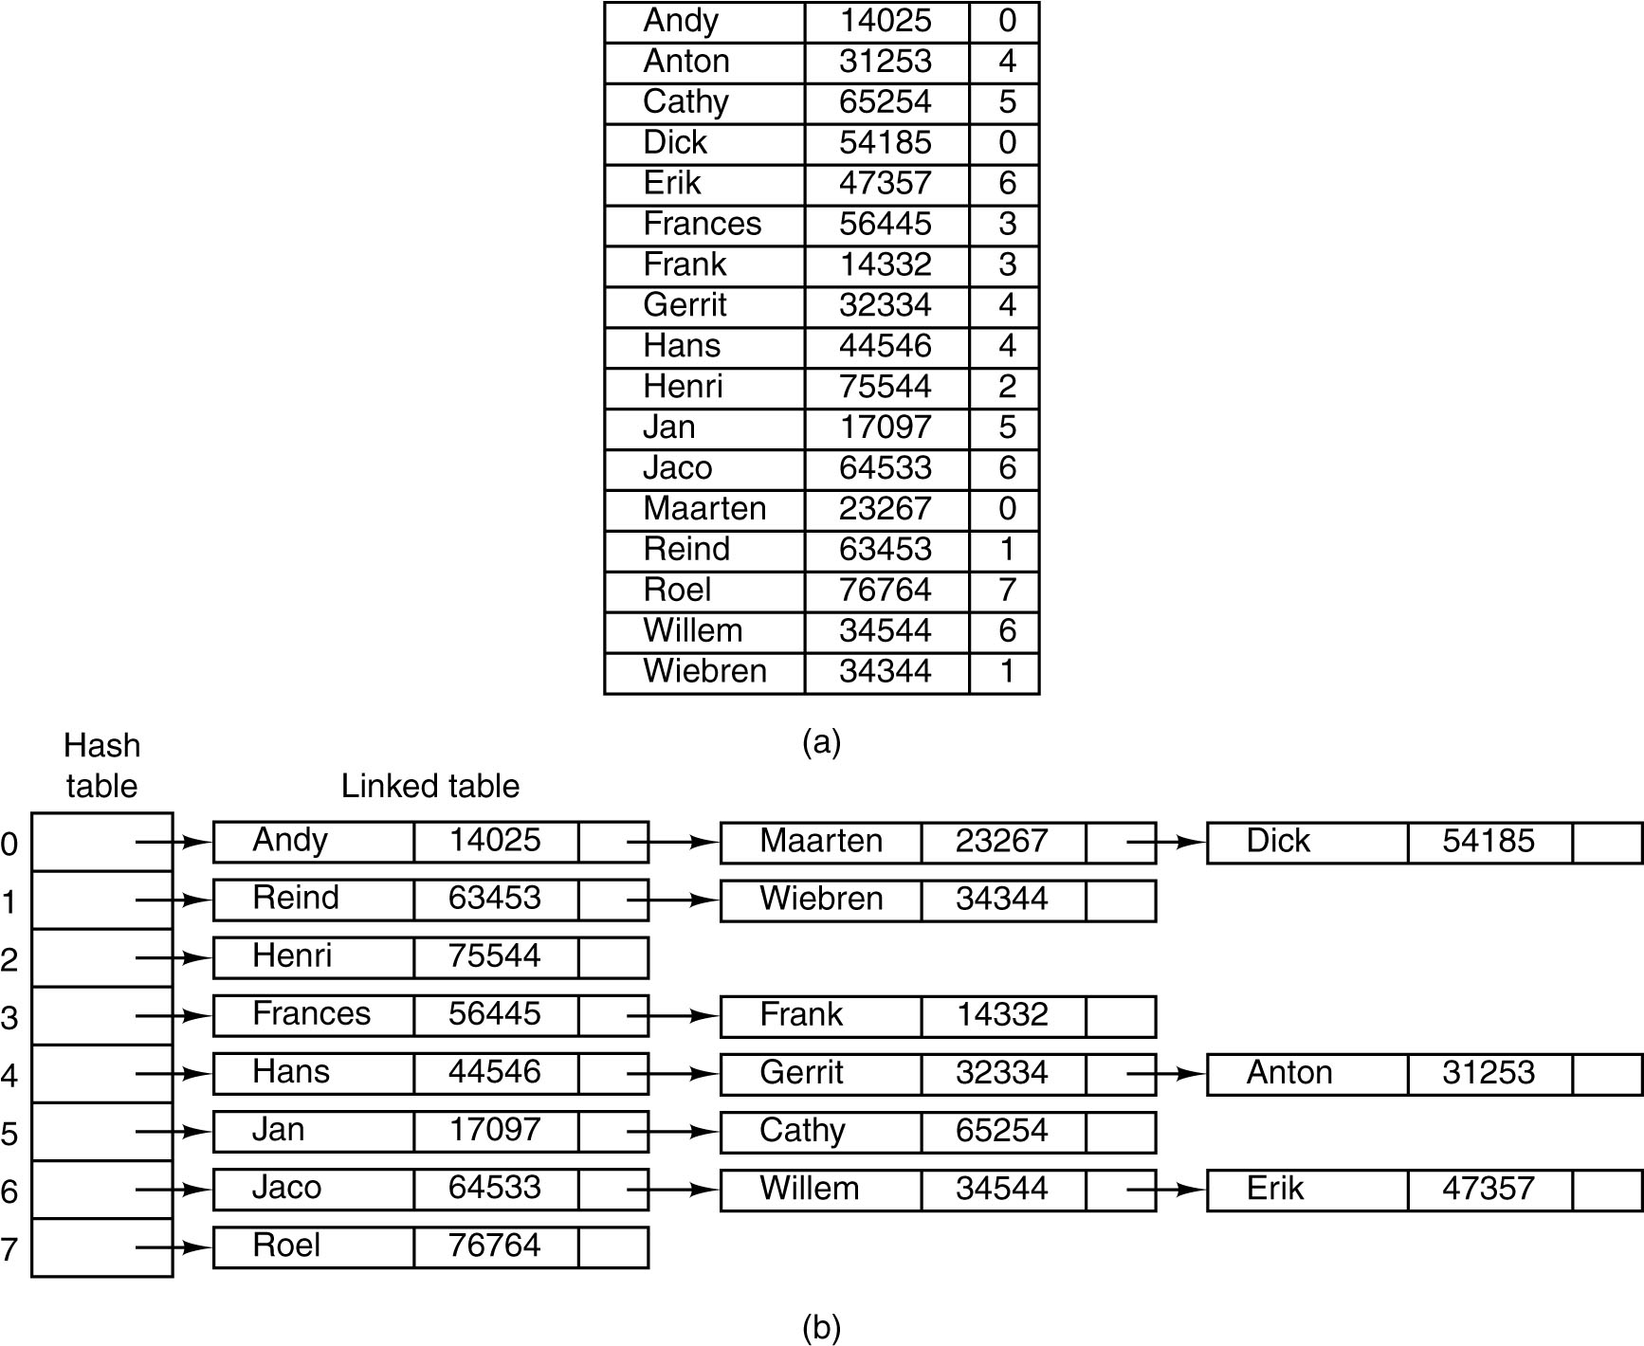
The Symbol Table (1)
Hash coding. (a) Symbols, values, and the hash codes derived from the symbols.

Slide 18
The Symbol Table (2)
Hash coding. (b) Eight-entry hash table with linked lists of symbols and values.

Slide 19
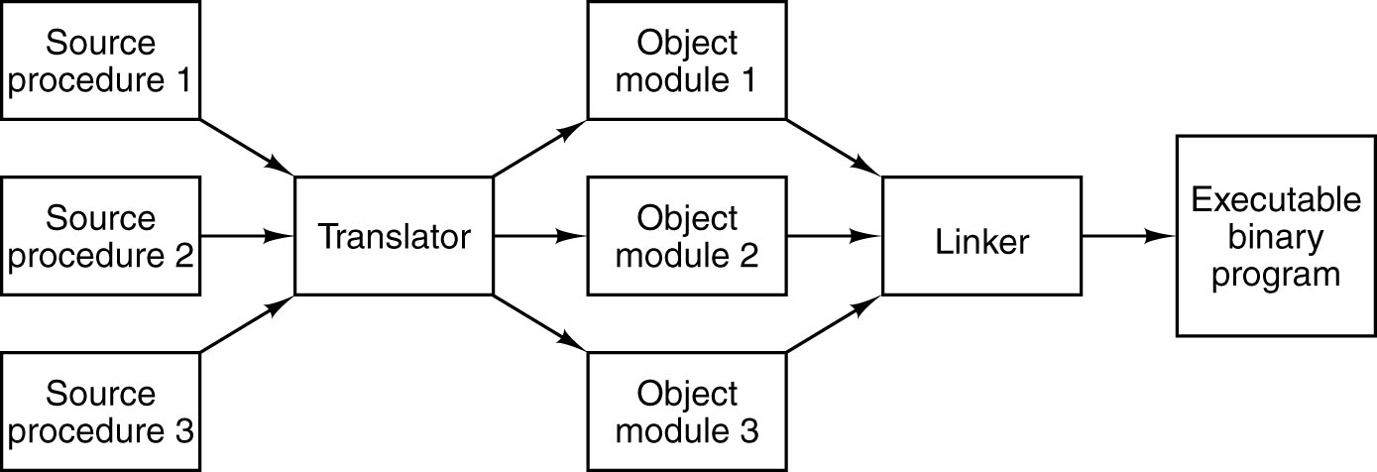
Linking and Loading
Generation of an executable binary program from a collection of
independently translated source procedures requires using a linker.

Slide 20
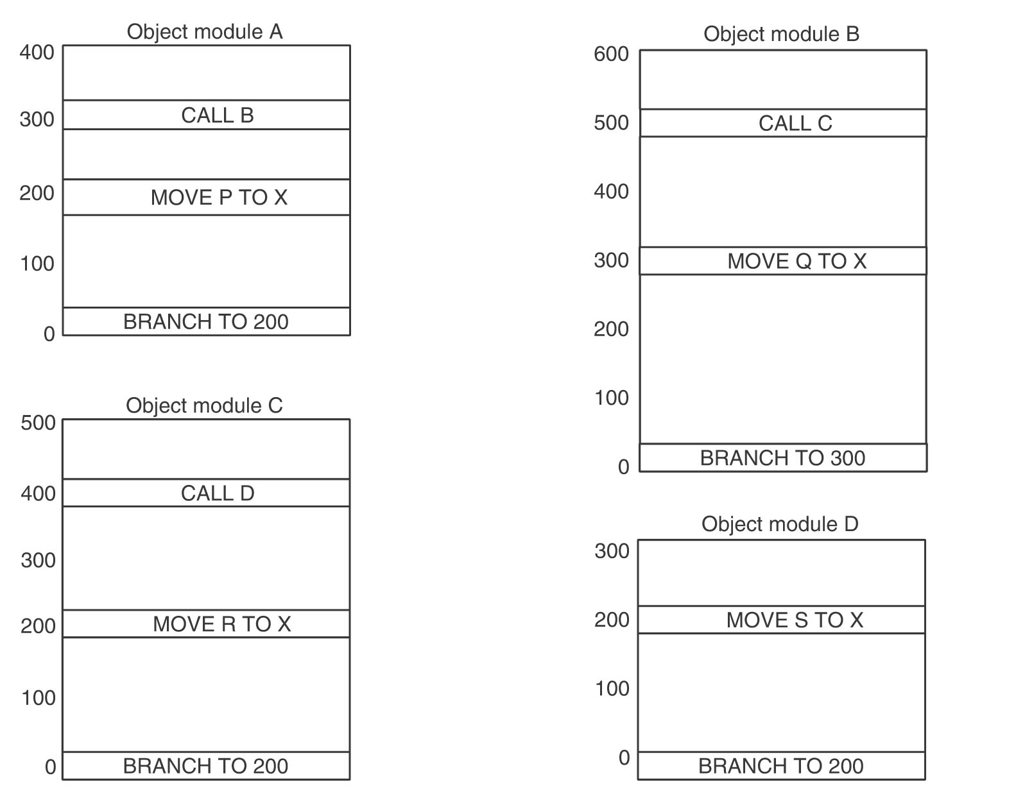
Tasks Performed by the Linker (1)
Each module has its own address space, starting at 0.

Slide 21
Tasks Performed by the Linker (2)
Each module has its own address space, starting at 0.

Slide 22
Tasks Performed by the Linker (3)
Each module has its own address space, starting at 0.

Slide 23
Tasks Performed by the Linker (4)
Each module has its own address space, starting at 0.

Slide 24
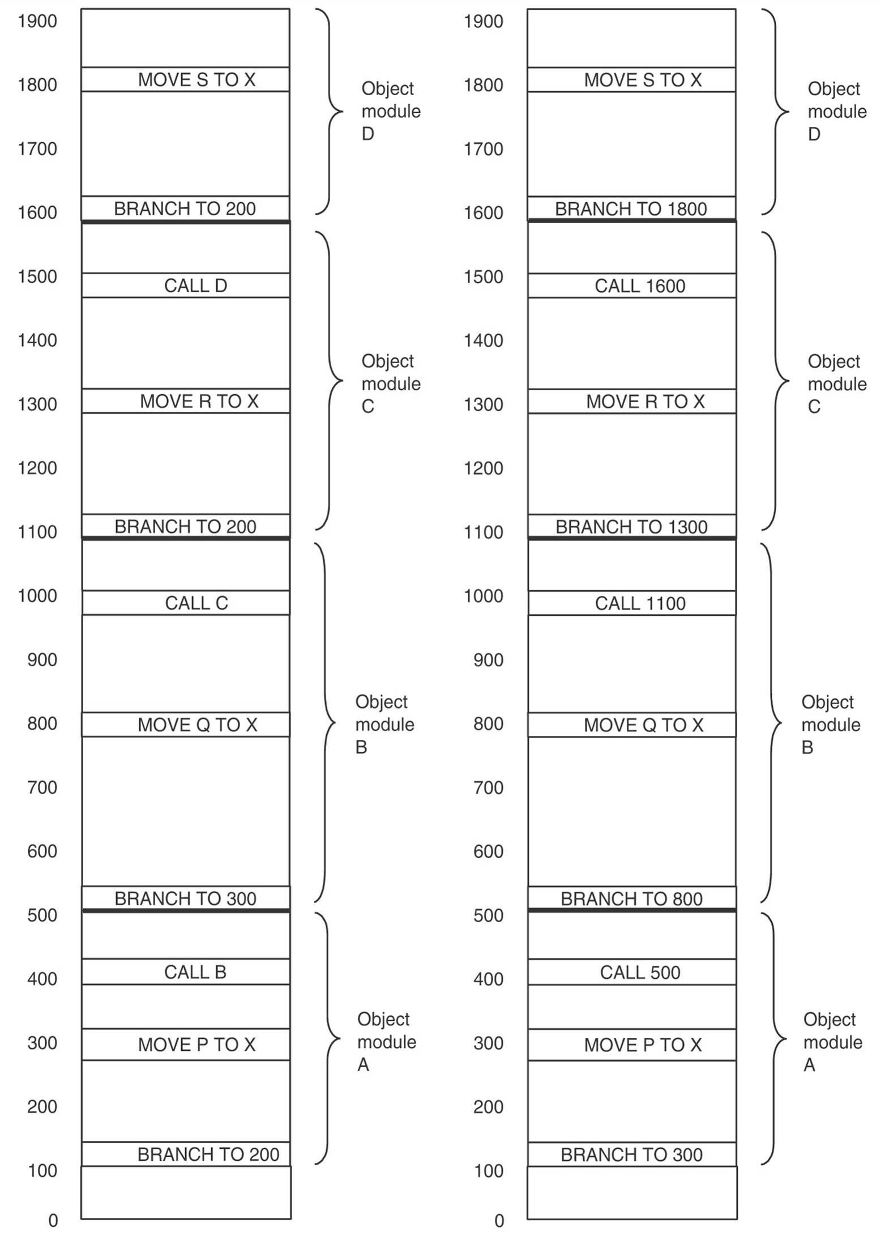
Tasks Performed by the Linker (5)
The object modules after being positioned in the binary image but before being relocated and linked.

Slide 25
Tasks Performed by the Linker (6)
The same object modules after linking and after relocation has been performed.
Together they form an executable binary program, ready to run

Slide 26
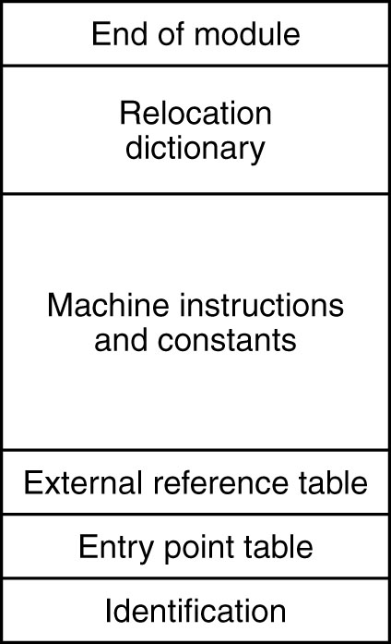
Structure of an Object Module
The internal structure of an object module produced by a translator.

Slide 27
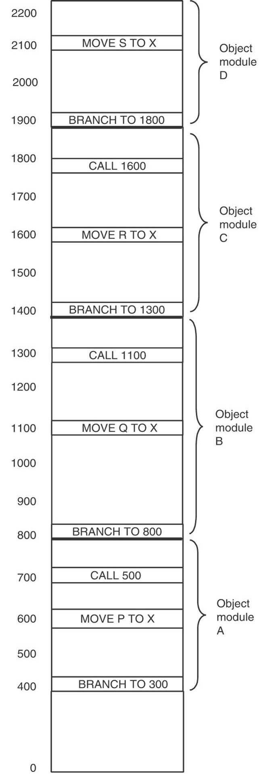
Binding Time and Dynamic Relocation
The relocated binary program of previous one moved up 300 addresses.
Many instructions now refer to an incorrect memory address.

Slide 28
The problem of moving programs that have already been linked and relocated is intimately related to the time at which the final binding of symbolic names onto absolute physical memory addresses is completed.
When a program is written it contains symbolic names for memory addresses, for example, BR L.
The time at which the actual main memory address corresponding to L is determined is called the binding time.
At least six possibilities for the binding time exist:
1.When the program is written.
2. When the program is translated.
3. When the program is linked but before it is loaded.
4. When the program is loaded.
5. When a base register used for addressing is loaded.
6. When the instruction containing the address is executed.

Slide 29
Two related issues are involved here.
First, there is the question of when symbolic names are bound to virtual addresses.
Second, there is a question of when virtual addresses are bound to physical addresses.
Only when both operations have taken place is binding complete.
When the linker merges the separate address spaces of the object modules into a single linear address space, it is, in fact, creating a virtual address space.
The relocation and linking serve to bind symbolic names onto specific virtual addresses.

Slide 30
Assume for the moment that the address space of were paged.
It is clear that the virtual addresses corresponding to the symbolic names A, B, C, and D have already been determined, even though their physical main memory addresses will depend on the contents of the page table at the time they are used.
An executable binary program is really a binding of symbolic names onto virtual addresses.
Any mechanism that allows the mapping of virtual addresses onto physical memory addresses to be changed easily will facilitate moving programs around in main memory, even after they have been bound to a virtual address space.
One such mechanism is paging. After a program has been moved in main memory, only its page table need be changed, not the program itself.

Slide 31
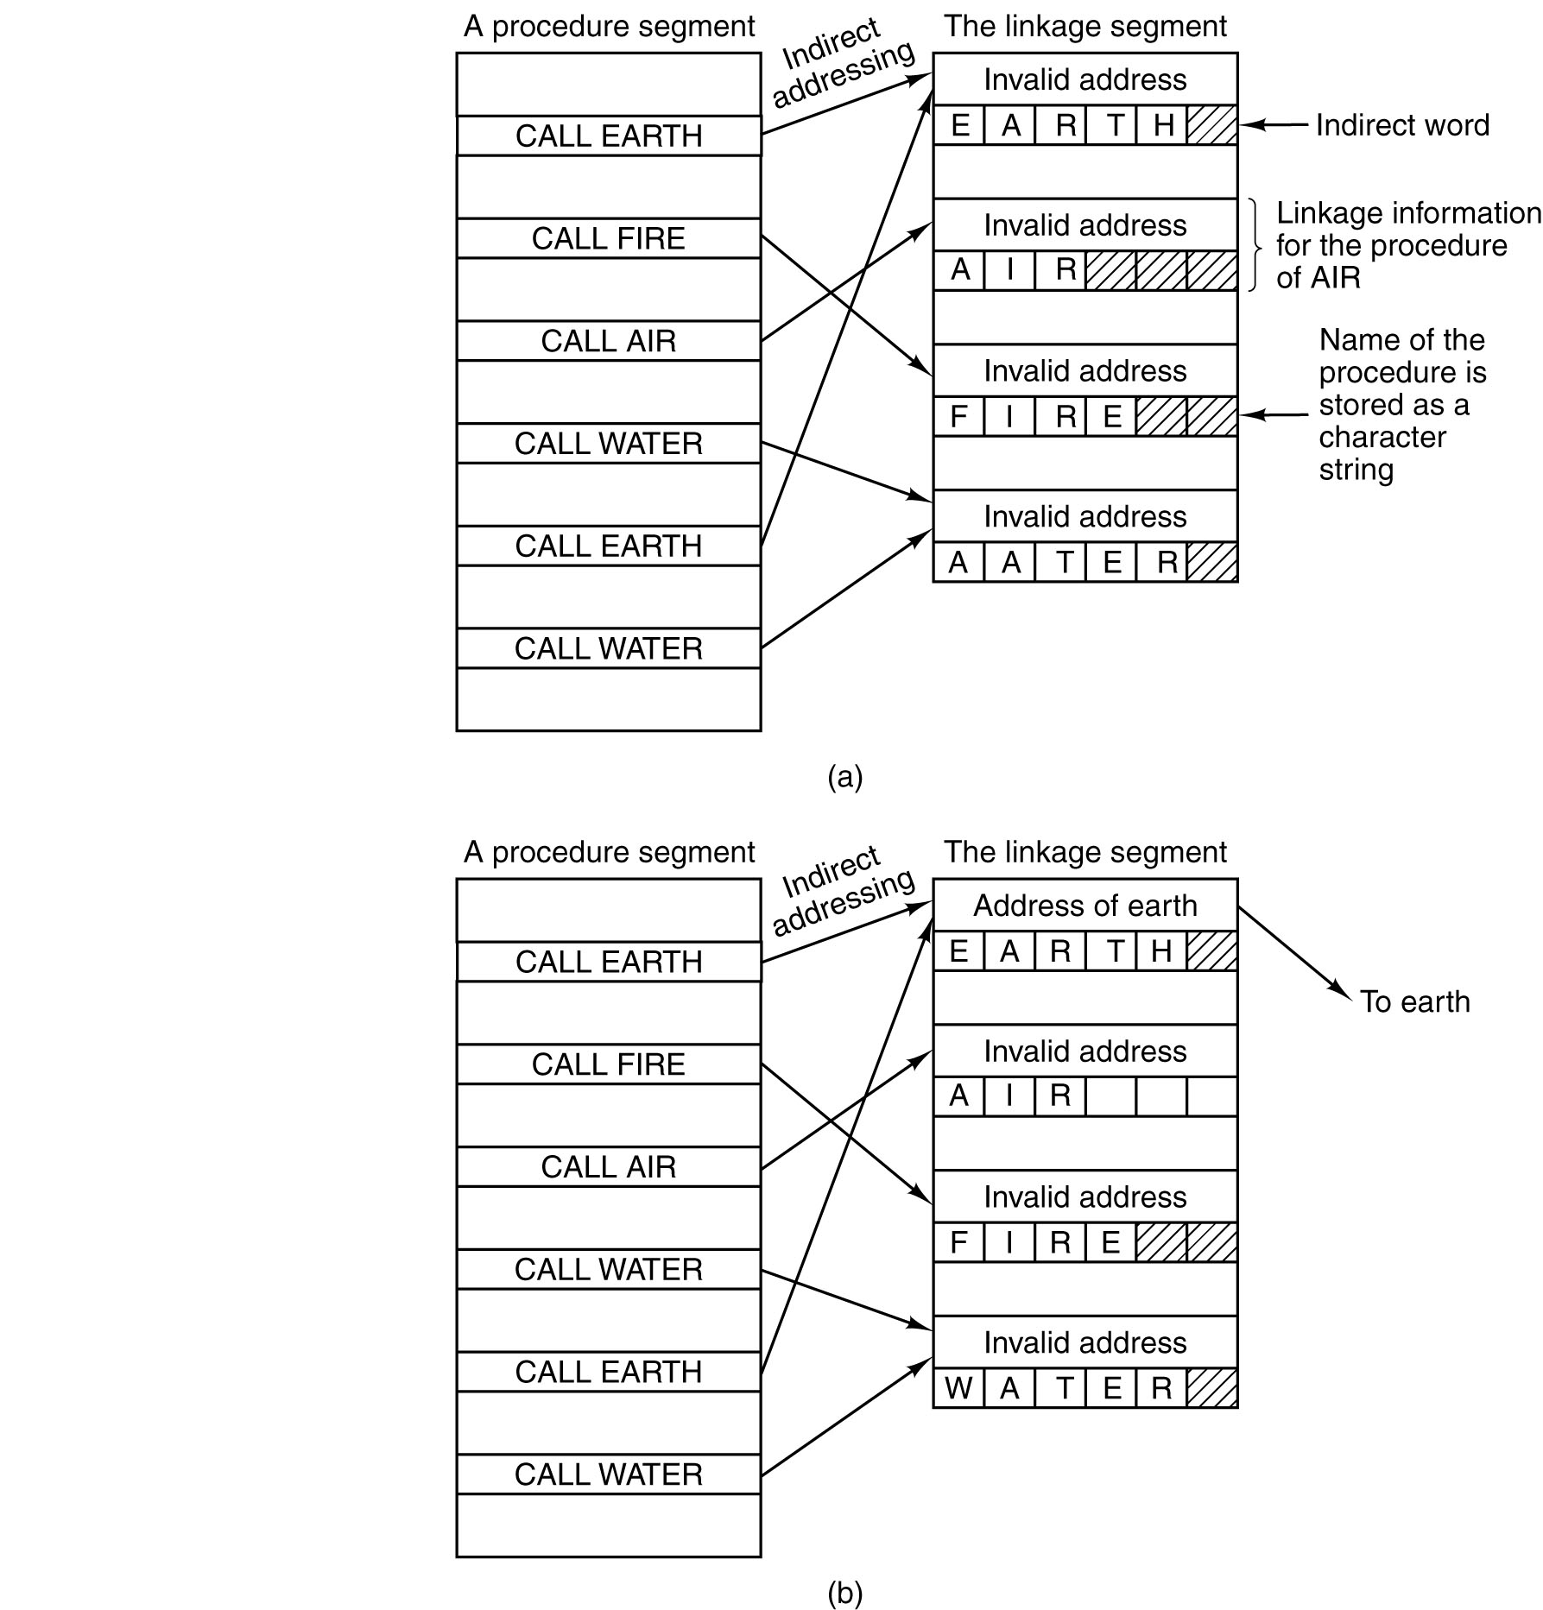
Dynamic Linking in MULTICS (1)
Before EARTH is called.

Slide 32
Dynamic Linking in MULTICS (2)
After EARTH has been called and linked.

